Slide 1
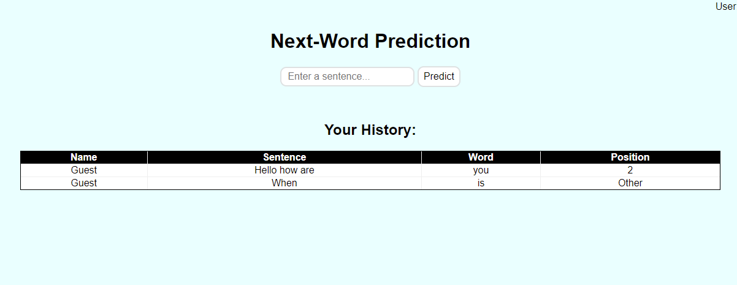
Next Word Predictor
Nick Elliott

Slide 2
Business Problem
Predictive text is everywhere, smartphone keyboards, google, youtube, and so on
Next-word prediction is a form of predictive text where only the next word is predicted
This project aims to create a next-word prediction application using a Recurrent Neural Network, specifically one using Long-Short Term Memory

Slide 3
Technology Stack
Languages: Python, HTML, CSS
Python Packages:
Web App - Flask
Machine Learning - TensorFlow & Keras
Tokenization - NLTK
Optimization - keras_tuner
Graphing - Matplotlib
Version Control: GitHub
Online Deployment: Heroku

Slide 4
Challenges During Execution
Training models that accurately predicted next-words
Finding good text corpuses of natural conversation
Creating appealing CSS styling
Online deployment with Heroku

Slide 5
Potential Future Improvements
Improved model trained on more data
Better ANN/algorithm for text generation
Compatibility with more languages
Custom options such as number of recommendations

Slide 6
Thank you

